Slide 1
Developing React Web Parts
Notes:
This module moves beyond SPFX fundamentals to examine the process of developing SPFX Web Parts for real-world scenarios. The module explains how to develop React Web Parts with a design that coordinates the movement of data between the Web Part class which defines persistent properties and the React component class which defines state. The module also teaches students how to leverage the Office UI Fabric React library to create a user interface using standard React components such as PrimaryButton, TextField and DetailsList. The module demonstrates how to develop Web Parts which use the SharePoint REST API to create new SharePoint lists and to update and query SharePoint list items. Along the way, students will learn essential SPFX programming techniques for executing calls asynchronously and for updating the user interface with a loading indicator whenever the user is waiting for a call to return from across the network.

Slide 2
Agenda
Designing and Developing React Web Parts
Web Part Properties versus React Component State
Leveraging the Office UI Fabric React Library
Developing Web Parts using the SharePoint REST API
Designing Web Parts to Manage SharePoint Lists

Slide 3
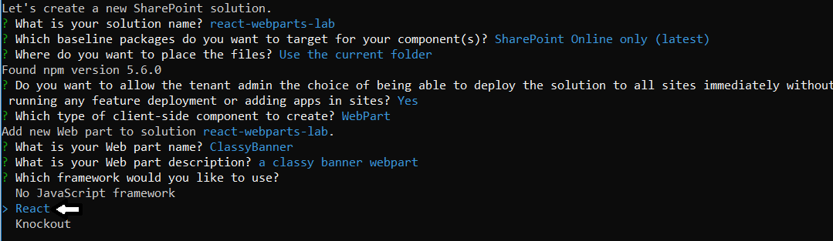

Slide 4
Agenda
Designing and Developing React Web Parts
Web Part Properties versus React Component State
Leveraging the Office UI Fabric React Library
Developing Web Parts using the SharePoint REST API
Designing Web Parts to Manage SharePoint Lists

Slide 5
Agenda
Designing and Developing React Web Parts
Web Part Properties versus React Component State
Leveraging the Office UI Fabric React Library
Developing Web Parts using the SharePoint REST API
Designing Web Parts to Manage SharePoint Lists

Slide 6
Summary
Designing and Developing React Web Parts
Web Part Properties versus React Component State
Leveraging the Office UI Fabric React Library
Developing Web Parts using the SharePoint REST API
Designing Web Parts to Manage SharePoint Lists

Slide 7
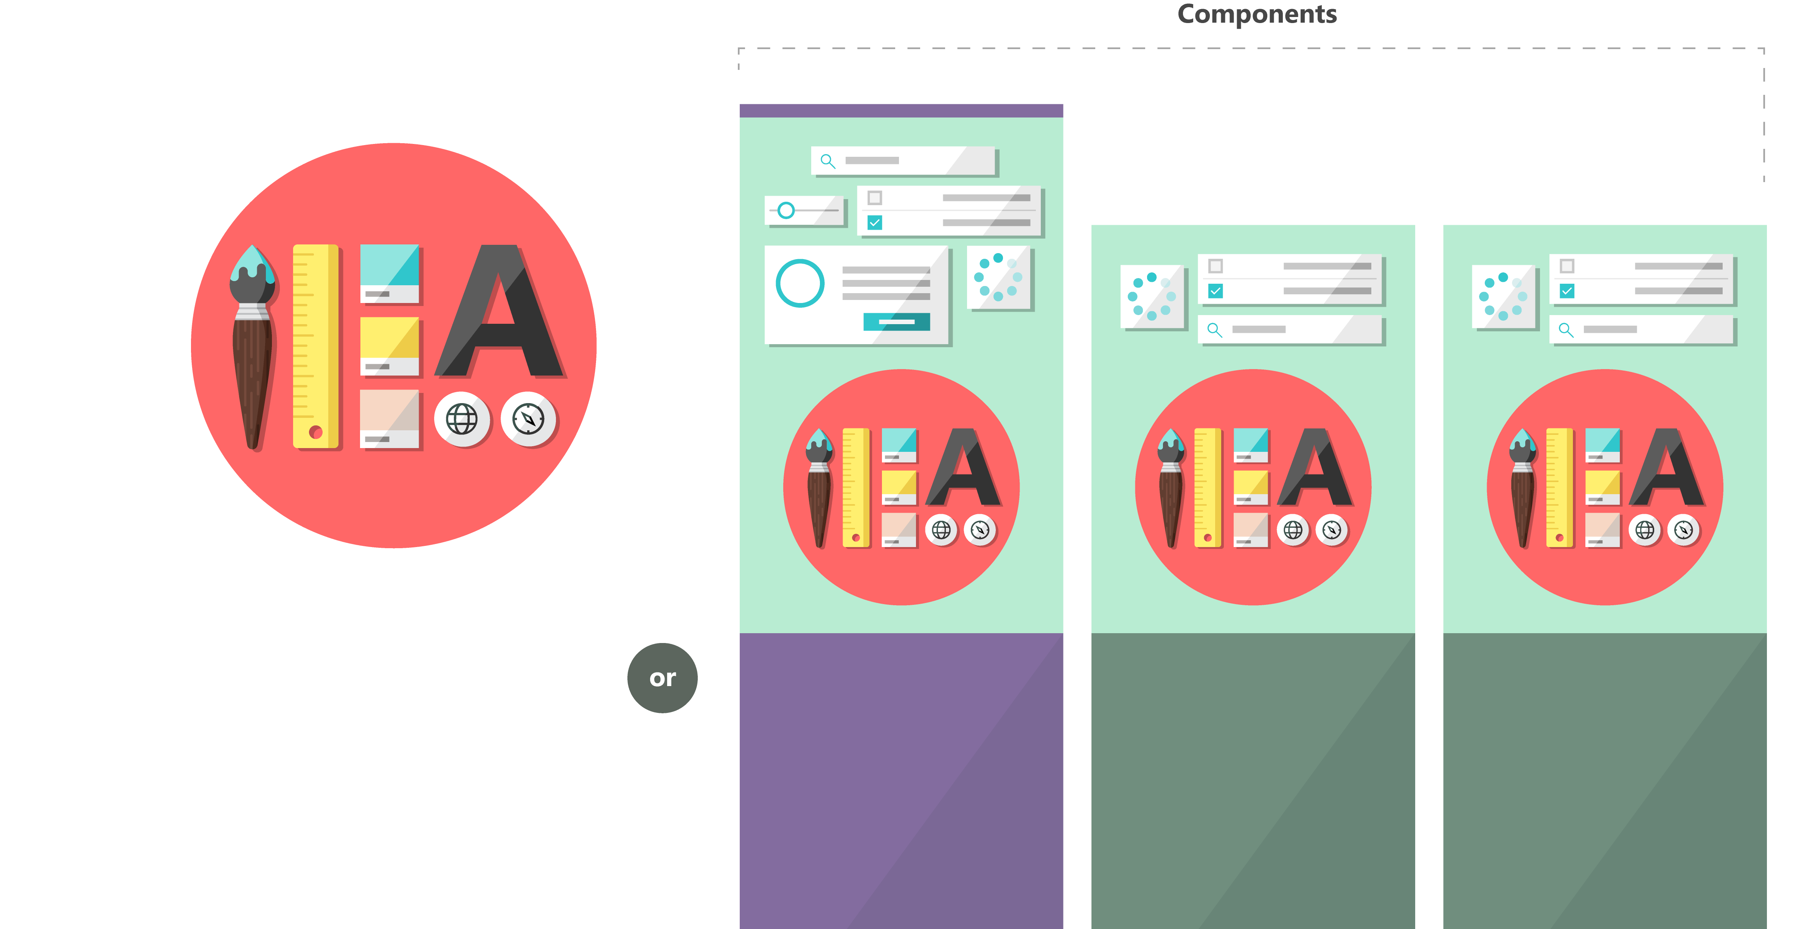

What is the Office UI Fabric?
Office UI Fabric is responsive, mobile-first, front-end style framework
Built by Microsoft to style Office 365, OneDrive and SharePoint sites
All about styling instead of JavaScript
Can be used by 3rd party developers
Fabric Core
Fabric React
Fabric JS
ngFabric
Fabric iOS
Core elements of the design language including icons, colors, type, and the grid
Robust, up-to-date components built with the React framework.
Simple, visuals-focused components that you can extend, rework, and build on.
Community-driven project to build components for Angular-based apps.
Native Swift colors, type ramp, and components for building iOS apps.

Slide 8
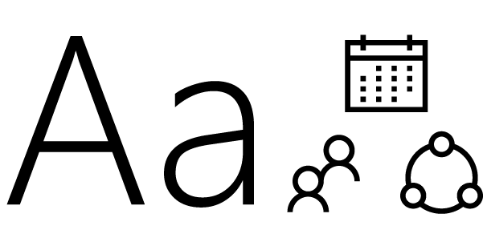
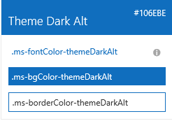

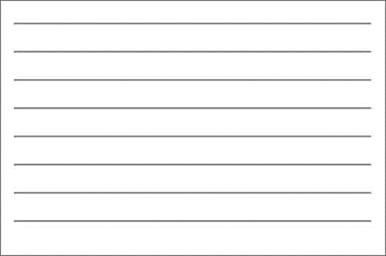

Fabric Core styling
Fonts and typography
Segoe font family + type ramp
Official Office 365 iconography
Color
Official Office 365 color palette
Branded assets
Product symbols + product filetype symbols
Animations
Official Office 365 selection of easings and animations
Responsive grid
Tailored to Office 365 silhouettes

Slide 9
Styles
The Office UI Fabric provides styles for..
Typography
Color
Icons
Animations
Responsive Grid
Localization

Slide 10
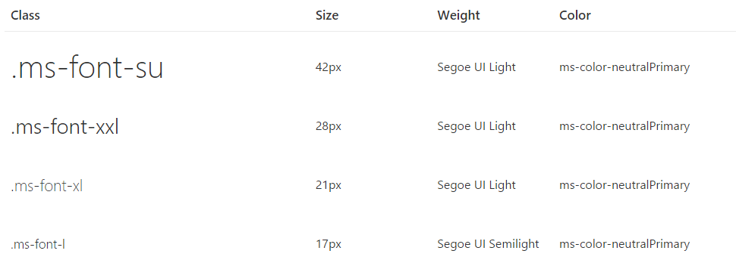
Typography
Base font classes
Fabric includes 10 base font classes
Each base class sets a default size, weight, and color.

Slide 11
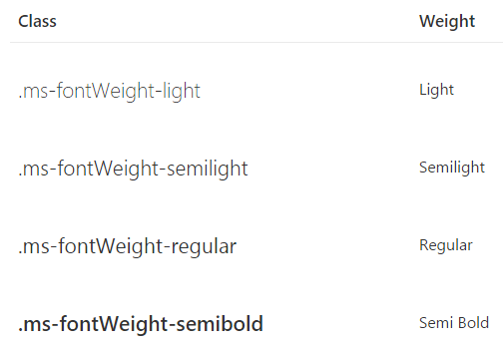
Typography
Helper font classes
There are helper font classes to change the text weight.

Slide 12
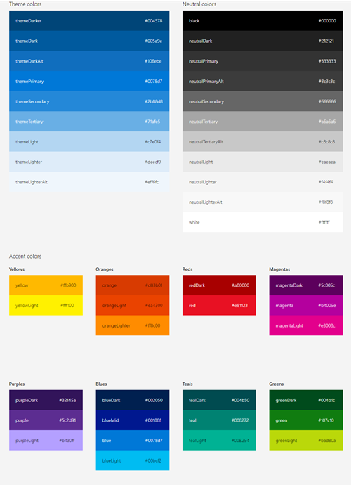
Color
Includes 9 theme colors and 11 neutral colors.
Helper classes for text, border, background, and hover states.
Color classes act as hooks into the Office 365 theming system

Slide 13
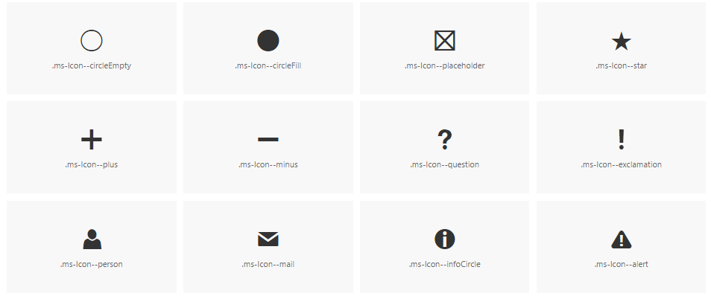
Icons
Fabric uses a custom font for its iconography.
Font contains glyphs you can scale, color, and style

Slide 14
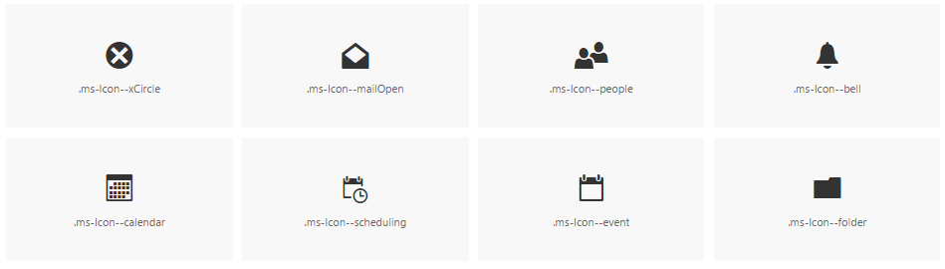
Icons
To use the icons, combine the base ms-Icon class with a modifier class for the specific icon.
<i class="ms-Icon ms-Icon--mail" aria-hidden="true"></i>

Slide 15

Dialog animations
When choosing a motion for dialogs, consider the origin and tone of the content.
For a warning or error dialog, a quick fade in might be appropriate.
If the dialog appears when a user chooses an item to get more information, a scale-up might be appropriate.

Slide 16
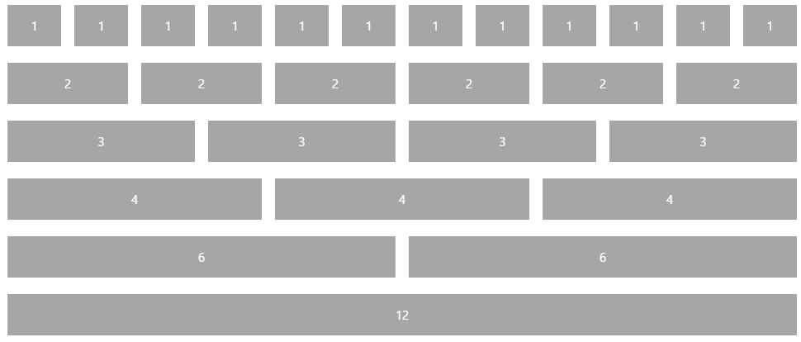
Responsive Grid
Fabric comes with a mobile-first, responsive grid
Based on 12 column grid
Used to create flexible layouts
<div class="ms-Grid">
<div class="ms-Grid-row">
<div class="ms-Grid-col ms-u-sm6 ms-u-md4 ms-u-lg2">First</div>
<div class="ms-Grid-col ms-u-sm6 ms-u-md8 ms-u-lg10">Second</div>
</div>
</div>

Slide 17
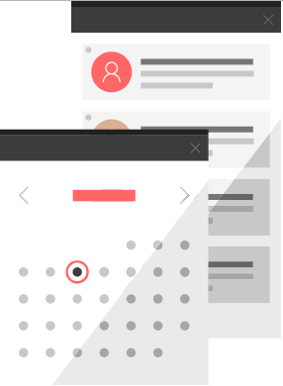
Office UI Fabric Components
Fabric's components are building blocks for UI
All JavaScript is presentational to explain behavior.

Slide 18
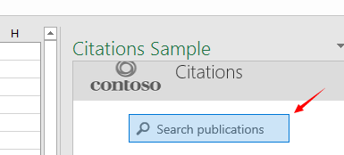
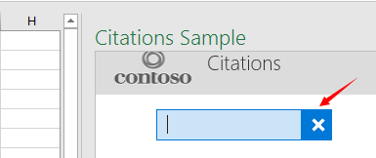
SearchBox
<div class="ms-SearchBox">
<label class="ms-SearchBox-label">
<i class="ms-SearchBox-icon ms-Icon ms-Icon--search"></i>
Search publications
</label>
<input class="ms-SearchBox-field">
<button class="ms-SearchBox-closeButton"><i class="ms-Icon ms-Icon--x"></i></button>
</div>

Slide 19
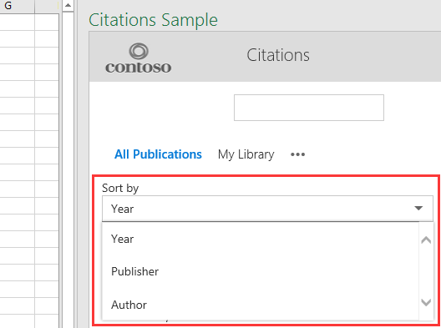
Dropdown
<div class="ms-Dropdown" tabindex="0" style="width:80%">
<i class="ms-Dropdown-caretDown ms-Icon ms-Icon--caretDown"></i>
<select class="ms-Dropdown-select">
<option>Year</option>
<option>Publisher</option>
<option>Author</option>
</select>
</div>

Slide 20
Agenda
Designing and Developing React Web Parts
Web Part Properties versus React Component State
Leveraging the Office UI Fabric React Library
Developing Web Parts using the SharePoint REST API
Designing Web Parts to Manage SharePoint Lists

Slide 21
Agenda
Designing and Developing React Web Parts
Web Part Properties versus React Component State
Leveraging the Office UI Fabric React Library
Developing Web Parts using the SharePoint REST API
Designing Web Parts to Manage SharePoint Lists

